Slide 1







amazon alexa

Slide 2
amazon alexa

Slide 3





History
In November 2014, Amazon announced Alexa
alongside Echo and created a revolution in the voice technology and changed the way
of interacting with the technology
The name Alexa was chosen due to the fact that it has a hard
consonant with the X and therefore could be recognized with higher
precision.
In June 2015, Amazon announced Alexa Fund, a program that
would invest in companies making voice control skills and technologies.
The US$100M in funds has invested in companies including Ecobee,
Orange Chef, Scout Alarm, Garageio, Toymail, MARA, and Mojio. In 2016
the Alexa Prize was announced to advance the technology.

Slide 4



Meet Amazon Alexa
“Alexa is an intelligent personal assistant developed by Amazon,
made popular by the Amazon Echo and the Amazon Echo Dot
devices developed by Amazon”
Controls several smart hone devices
Capable of,
▪ Voice Interaction
▪ Music Playback, whether updates, listen to news
▪ Providing real time information
▪ Order things on amazon, Zomato, dominos
▪ Book a ride on Uber or Ola
▪ Controls several smart home devices

Slide 5




1
Amazon Echo
Amazon’s Echo is a smart voice activated speaker
With built in web intelligence. It is always on and helps you to
Connect with the Alexa. it’s capable of doing many things just
using nothing but the sound of your voice, you can search the
Web, create to-do and shopping lists, shop online, get instant
weather reports, and control popular smart-home products

Slide 6

Alexa
“Alexa, What is my
Credit Card Balance “
“Alexa, nearest bank
to me“
“Alexa, turn on
welcome home“
“Alexa, turn on the
TV“
“Alexa, my last 5
transaction“

Slide 7
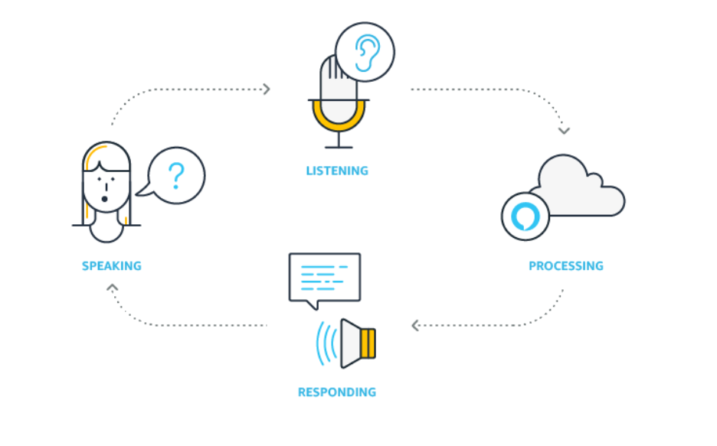


Process is easy

Slide 8

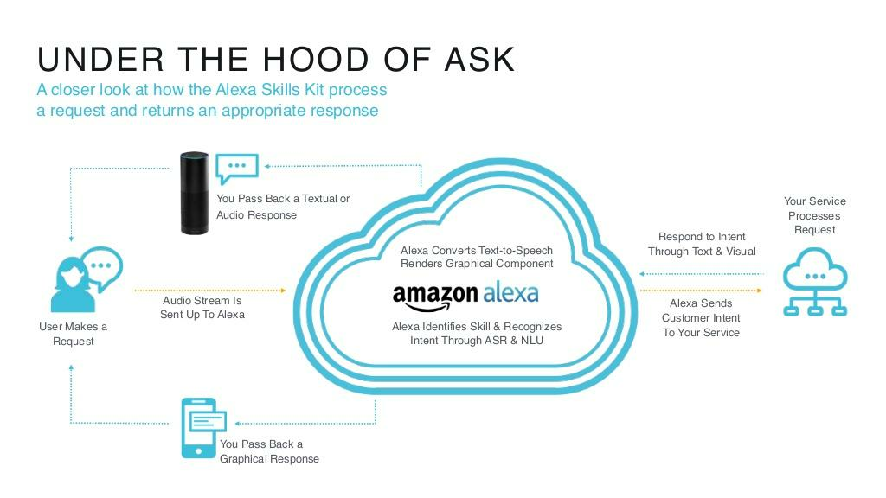
Text-to-Speech(TTS)
Natural Language Understanding(NLU)
Automatic Speech Recognition(ASR)
Machine Learning
Want big
impact?
Use big
image.

Slide 9




Two Powerful Frameworks
“

Slide 10
Skills = Apps

Slide 11
Apps
Alexa Skills
◇ Enhances the capabilities of your device
◇ Enhances Alexa capabilities
“
◇ You Install an App
◇ You Enable a Skill
◇ You Uninstall the App
◇ You Disable the Skill
◇ the App Store
◇ the Alexa Skills Store
◇ You can rate, review and
give feedback
◇ You can rate, review and
give feedback

Slide 12
Alexa Skills Kit
◇ Alexa Skills Kit is a software development kit(SDK)
that enables the developer to create skills or conversational
applications for the Alexa.
◇ It comprises of API tools, code samples, documentations that
enables the developers to add skills to the 10,000+ voice
recognition capabilities available on Alexa.

Slide 13
Alexa Voice Service(AVS)
◇ Alexa Voice Service helps the developers to add Alexa to new devices. From smart speakers to mobile phones to cars to smart home appliances
◇ It helps developers to build Alexa enabled products and helps the customers to get amazing hands free experience
◇AVS has natural voice control ◇ It is always getting smarter
◇Easy to Integrate ◇ free to use
“

Slide 14
Intents and Utterances

Slide 15

Heading
Content
Article

Slide 16
Alexa, Open Space Facts
“
Wake Word
Starting Phrase
Skill Invocation Name

Slide 17
Alexa, Open Space Facts and tell me a fact
Wake Word
Skill Invocation Name
Utterances
Starting Phrase
Connecting Word

Slide 18
Intent
GetNewFactIntent
Alexa, Open Space Facts and tell me a fact
Alexa, Open Space Facts and give me a fact
Alexa, Open Space Facts and tell me a space fact
Alexa, Open Space Facts and give me a space fact
Alexa, Open Space Facts and tell me a space trivia
Alexa, Open Space Facts and tell me something about space
Alexa, Open Space Facts and give me a trivia
Alexa, Open Space Facts and tell me something interesting about space
Alexa, Open Space Facts and give me some space information
Utterances

Slide 19
Slots

Slide 20
Utterances
Give me the list of festivals in January
Give me the list of festivals in February
Give me the list of festivals in March
Give me the list of festivals in April
Give me the list of festivals in May
Give me the list of festivals in June
Give me the list of festivals in July
Give me the list of festivals in August
Give me the list of festivals in September
Give me the list of festivals in October
Give me the list of festivals in November
Give me the list of festivals in December

Slide 21
Give me the list of festivals in {Month}
{Month}
January
February
March
April
May
June
July
August
September
October
November
December
SLOT
“

Slide 22

Creating an Alexa Skill
Frontend Definition
Backend Code
</>
Developer.amazon.com
Skill store information
Interaction model (VUI)
Configuration (Lambda, REST)
Testing
Publishing
aws.amazon.com
Lambda (Node.js, Python)
S3
DynamoDB

Slide 23
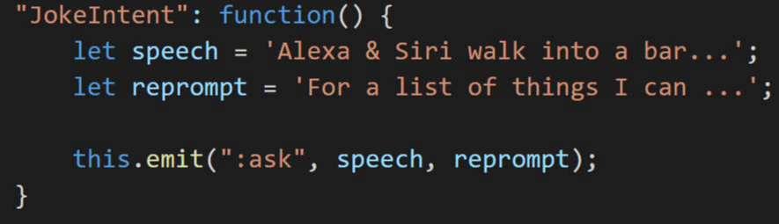
Creating an Alexa Skill
</>
Developer.amazon.com
Utterances
aws.amazon.com
Tell me a joke
Give me a joke
Get a joke
Another joke
Something funny
Some humor
JokeIntent

Slide 24

Thanks!
Any questions?

Slide 25
“
// Lets Build

